Slide 1
Software Design Document: MUST Online Voting Website System (MOVS)

Slide 2
Introduction:
The purpose of this software design document is to outline the system architecture and design for a Must online voting website system. This system will allow registered voters to securely and anonymously cast their votes in various elections.

Slide 3
Project Requirements:
User Registration: The system must allow users to register for an account to access the voting system.
Voter Authentication: The system must authenticate voters using a secure login process.
Ballot Creation: The system must allow authorized users to create ballots for various elections.
Vote Casting: The system must allow registered and authenticated voters to cast their votes for elections.
Results Reporting: The system must generate accurate and timely results for elections.

Slide 4
Architecture:
The system will use a three-tier architecture, with the presentation tier, application tier and data tier.

Slide 5
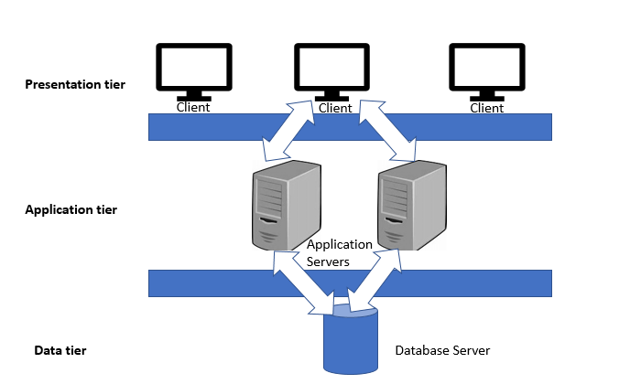

Slide 6
Presentation Tier: The presentation tier will include the website user interface, which will allow voters to interact with the system.
Application Tier: The application tier will include the business logic and server-side programming, which will handle user authentication, ballot creation, vote casting, and results reporting.
Data Tier: The data tier will include the database that stores user account information, ballot data, and election results.

Slide 7
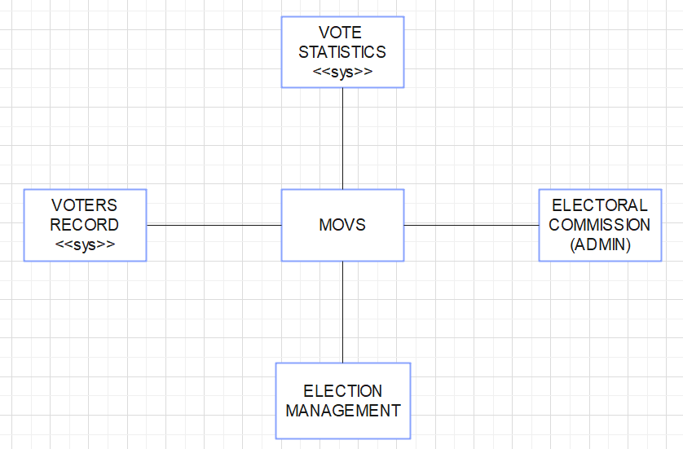
THE CONTEXT OF MOVS
The context model below shows the relationship between MOVS and other systems.

Slide 8
SYSTEM BOUNDARIES OF MOVS
The system boundary for an online voting website would include all the components and processes that are necessary for the website to function as a secure and reliable platform for voters to cast their votes. This would include the following:
User Interface: The website user interface will allow voters to register for an account, authenticate themselves, view available elections, and cast their votes. The user interface will be designed to be simple and intuitive, with clear instructions and error messages.

Slide 9
SYSTEM BOUNDARIES OF MOVS (Contd..)
Authentication and authorization: This would include secure login credentials, multi-factor authentication, and role-based access control for different user types.
Voting process: This would include the ballot design, vote submission, and confirmation message to ensure that the vote has been successfully submitted.
External Systems Integration: The system boundary would include the integration with external system such as SIMS.

Slide 10
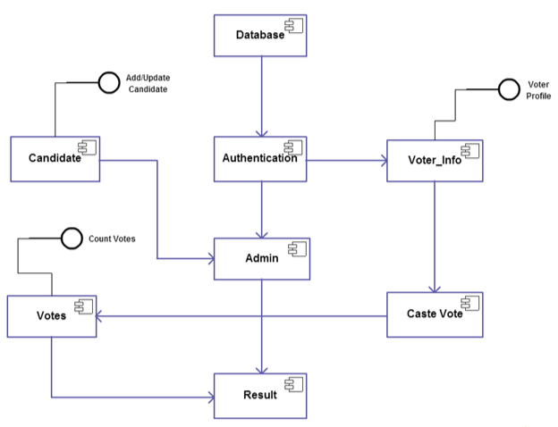
PROCESS MODEL OF MOVS
The process model of Must online voting website outlines the steps involved in the voting process, from the initial registration of voters to the final result of votes.

Slide 11
INTERACTION MODEL OF MOVS
The interaction model of an online voting website outlines the interactions between the website and its users.
Use case diagrams and sequence diagrams may be used for interaction modelling.
By using use-case diagrams, use case modeling is a technique used in software engineering to describe the behavior of a system from the perspective of its users.

Slide 12
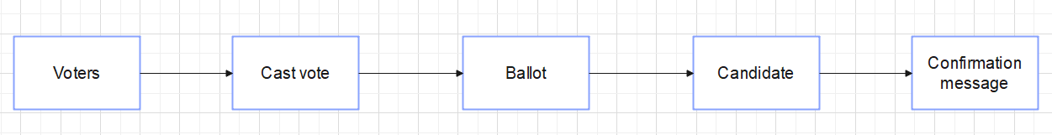
USE CASE DIAGRAM OF MOVS
In the "Cast Vote" scenario for MOVS, the actor is the voter. The voter is the user who interacts with the system to cast their vote.

Slide 13
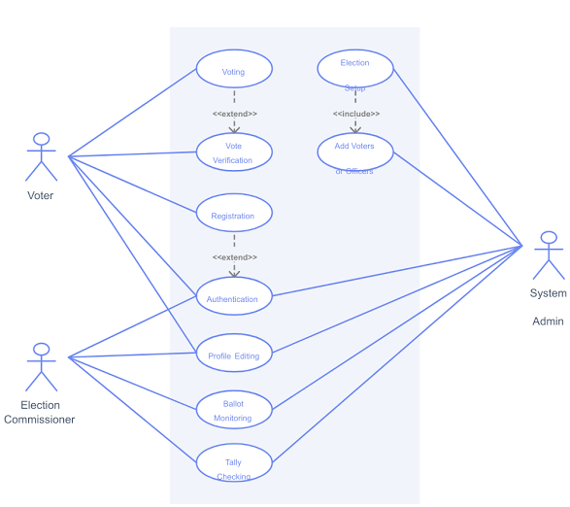
USE CASES IN THE MOVS INVOLVING ROLE OF EACH PARTICIPANT

Slide 14
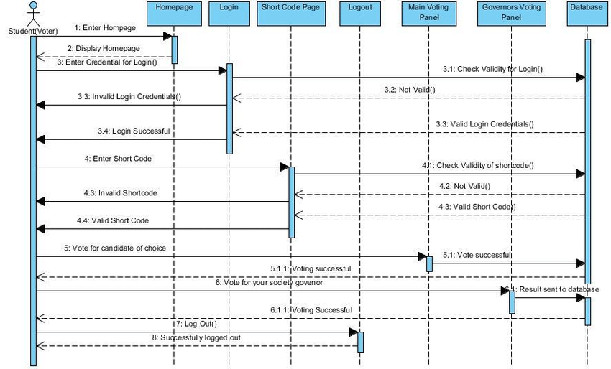
SEQUENCE DIAGRAMS OF MOVS
Sequence diagrams can be used to illustrate the interactions between different components of an online voting website.

Slide 15
CONCLUSION
This software design document outlines the architecture and design for a secure and reliable voting website system. The system will be optimized for performance, scalability, and security, and will provide a simple and intuitive user interface for voters to cast their votes securely and anonymously.

